Slide 1
Assignment 4
Kevin Jesse, Mingyang Zhou

Slide 2
Assignment 4
Instructions are on canvas
Download the code and data from canvas
Due Mar 19 at 2pm

Slide 3
Sentiment Analysis
Using Naive Bayes we will be classifying movie reviews
Homework will compare implementations of Naive Bayes with 3 modifications
Using StopWords, Binarized, and Custom

Slide 4
Naive Bayes
Naive Bayes depends on the underlying assumption that there is independence among predictors
“An apple is considered to be an apple if it is red, round, and 4 inches in diameter”

Slide 5
Pros and Cons Naive Bayes
Pros
Easy and fast to predict classes of test data
If independence between features is true, than Naive Bayes classifier performs better than most models ie logistic regression with less training data
Rather than tuning parameters on each learned step, Naive Bayes just calculates them

Slide 6
Pros and Cons Naive Bayes
Cons
Cannot categorized for a category not observed well in training.
Zero Frequency problem: smoothing helps
Bad estimator
Assumption of independence is rare in most data sets

Slide 7
Intro: Scripts and Data
NaiveBayes.py: The starter code file for you to implement three types of naive bayes classifier for movie review sentiment analysis.
data/imdb: 1000 positive reviews and 1000 negative reviews.
data/english.stop: a set of English stop words.

Slide 8
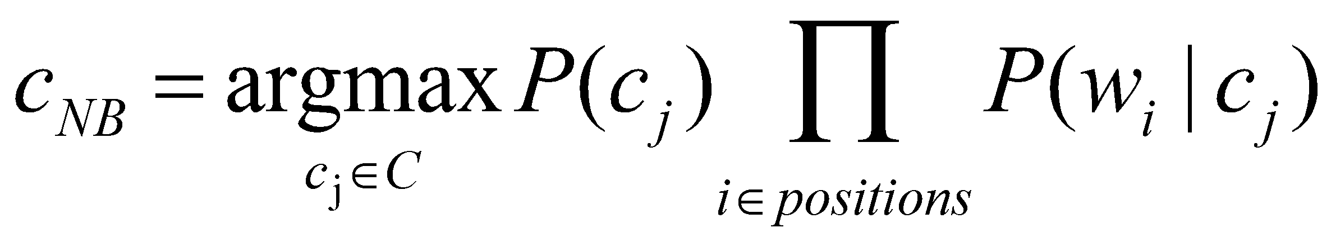
Task 1
Implement a basic naive bayes classifier to predict the sentiment for movie review.
What is the probability of a particular sentiment given a feature?
How does this feature relate to other features (weighting features)
Notes:
Get the performance using the scripts we provide

Slide 9
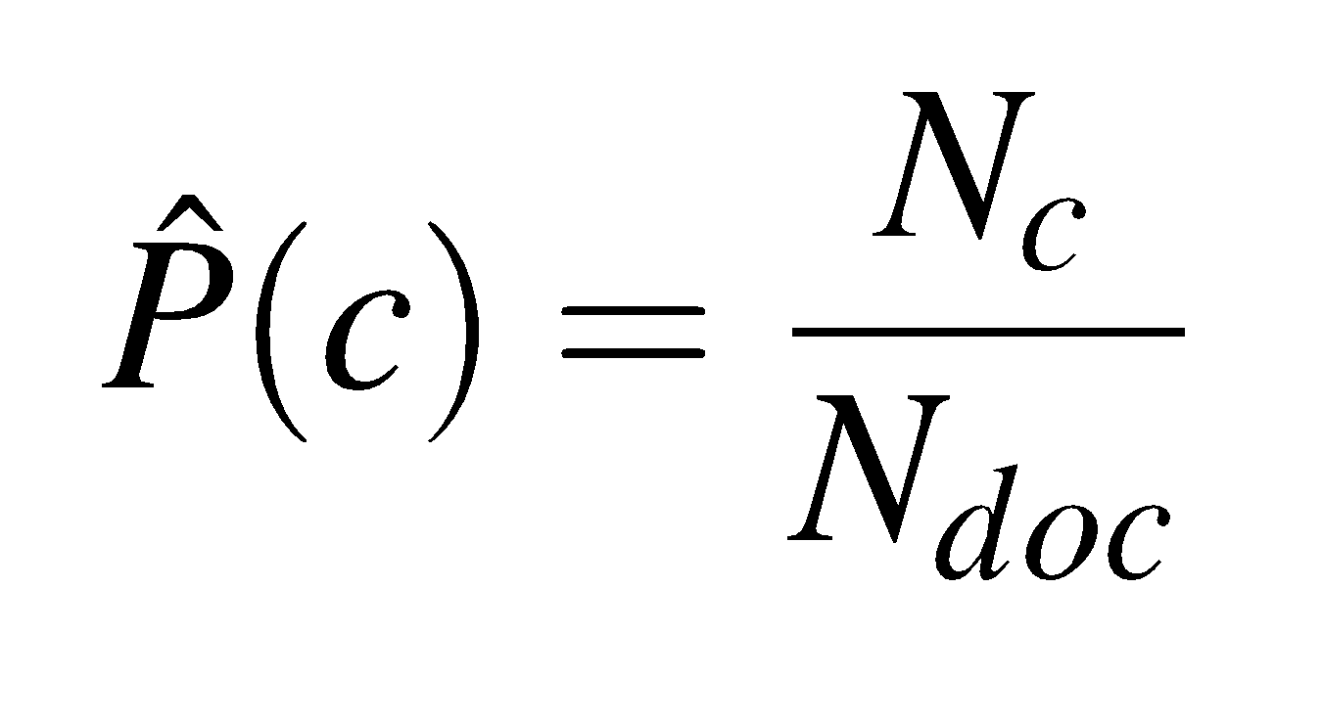
Task 1
Implement a basic naive bayes classifier to predict the sentiment for movie review.
Let N_{c} be number of documents with class c
Let N_{doc} be total number of documents
Notes:
Get the performance using the scripts we provide

Slide 10
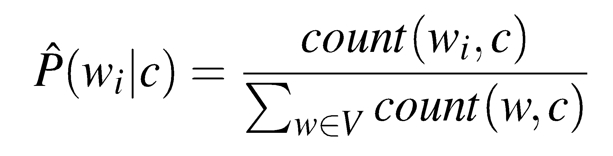
Task 1
Implement a basic naive bayes classifier to predict the sentiment for movie review.
Notes:
Get the performance using the scripts we provide

Slide 11
Task 1
Run:
Python NaiveBayes.py data/imdb
What is the prediction accuracy you get?
Is the distribution of positive to negative reviews balanced for training?

Slide 12
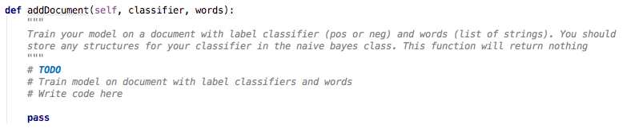
Adding Reviews to Model
What information is worth retaining?
# of classifications per across corpus?
Word frequency?
Word frequency per sentiment?
Maintain these structures within your Naive Bayes class

Slide 13
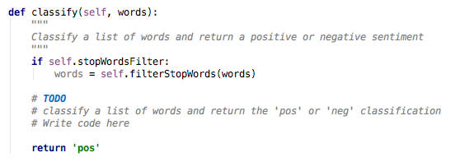
Adding The Classifier
You will need to calculate the following:
Probability of positive and negative reviews in the corpus
P(Pos) = #Pos/(#Pos + # Neg)
P(Neg) = #Neg/(#Pos +# Neg) or 1-P(Pos)
More on the next slide...

Slide 14
Adding The Classifier
You will need to calculate the following:
Score for positive and negative sentiment (hint: do one at a time)
What we want to do (C_j is our positive/negative sentiment)
-log(P(C_j)*P(w1|C_j)*P(w2|C_j)*...P(wN|C_j))
This is equal to saying
P(sentiment)*[P(w1, sentiment) * P(w2, sentiment) … P(wN, sentiment)]
Using -log we can continuously decrement each probability (word probability for a sentiment) and finally multiple/decrement the probability of the sentiment itself.

Slide 15
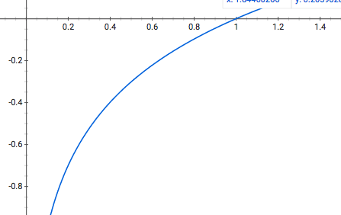
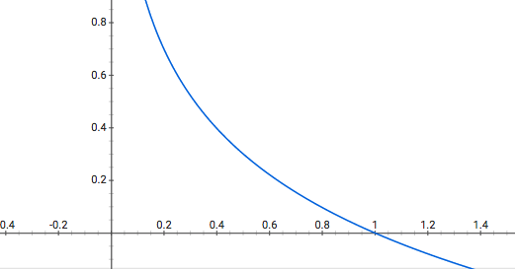
Adding The Classifier
Using -log we can continuously decrement each probability (word probability for a sentiment) and finally multiple/decrement the probability of the sentiment itself.
Start at score of 0, decrement by -log(Prob(Words, Sentiment))
log(x) -log(x)

Slide 16
Task 2
Evaluate the model with the stop words removed.
Run
Python NaiveBayes.py -f /data/imdb
Does this approach affect average accuracy? Explain why removing stop words helped?

Slide 17
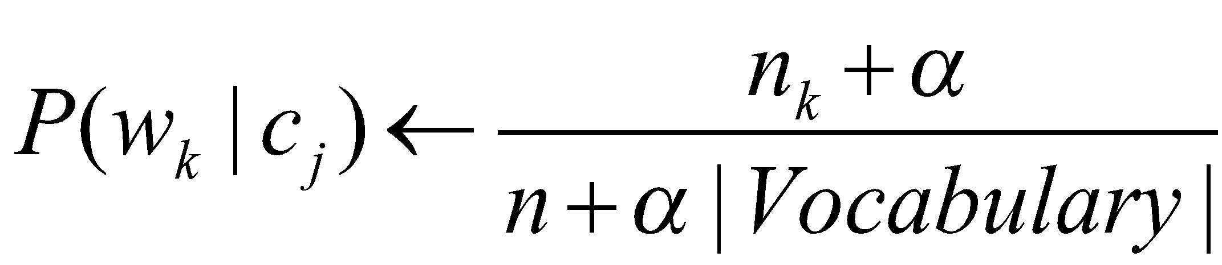
Task 3
Implement a binarized version of the Naive Bayes Classifier.
Clip all the word counts in each document at 1.
For each word w_{k} in Vocabulary
n_{k} ← # of docs belong to c_{j} that contain w_{k}

Slide 18
Task 3
Run
Python NaiveBayes.py -b data/imdb
Did you get improvement, when compared to basic naive bayes classifier?

Slide 19
Task 4
Design new features and heuristics to enhance your movie review sentiment predictor.
Run
Python NaiveBayes.py -m data/imdb
Example of new heuristics:
Add “NOT_” to all the words after you detect a negation in the document.

Slide 20
Task 4
Constraints:
Only change features, but not the classifier method. You can only use naive bayes for this assignment.
You cannot use any external python packages other than the default ones that python have.
Limit your changes to addDocument() and classify() as much as you can. Changes beyond addDocument() and classify() needs to be done with cautions.

Slide 21
Task 4
Goals:
Minimum requirement: (1) Your best model should be achieve higher probability than your basic naive bayes classifier and the binary version naive bayes classifier. (2) It will need to achieve at least 83% average accuracy with the 10-fold cross validation on imdb dataset. (3) It will need to achieve a higher accuracy than a TA model on the hold out dataset.
Competitive Task: Improve your classifier as much as you can! We will test all your classifiers with a hold out dataset. The top 10% classifier with the highest prediction accuracy will be awarded 5 bonus points for this assignment.

Slide 22
Task 4
Some suggestions on how to improve:
Properly handle negation and turns in the sentence:
I had heard this movie was very good, but I found it bad.
The movie is neigher inspired nor realistic.
2. Appropriate feature selection. Removing stop words is a simple version of this process. Consider what words contribute to a certain sentiment more.

